Slide 1
Web-based Air Pollution Monitoring System
GROUP MEMBERS:
ABDUL BASIT (FA17-BCE-062)
AISHA KHAN (FA17-BCE-081)
AROOJ SHAFIQUE (FA17-BCE-083)
NABIA IMRAN (FA17-BCE-004)
Supervisor: Usman Rafique

Slide 2
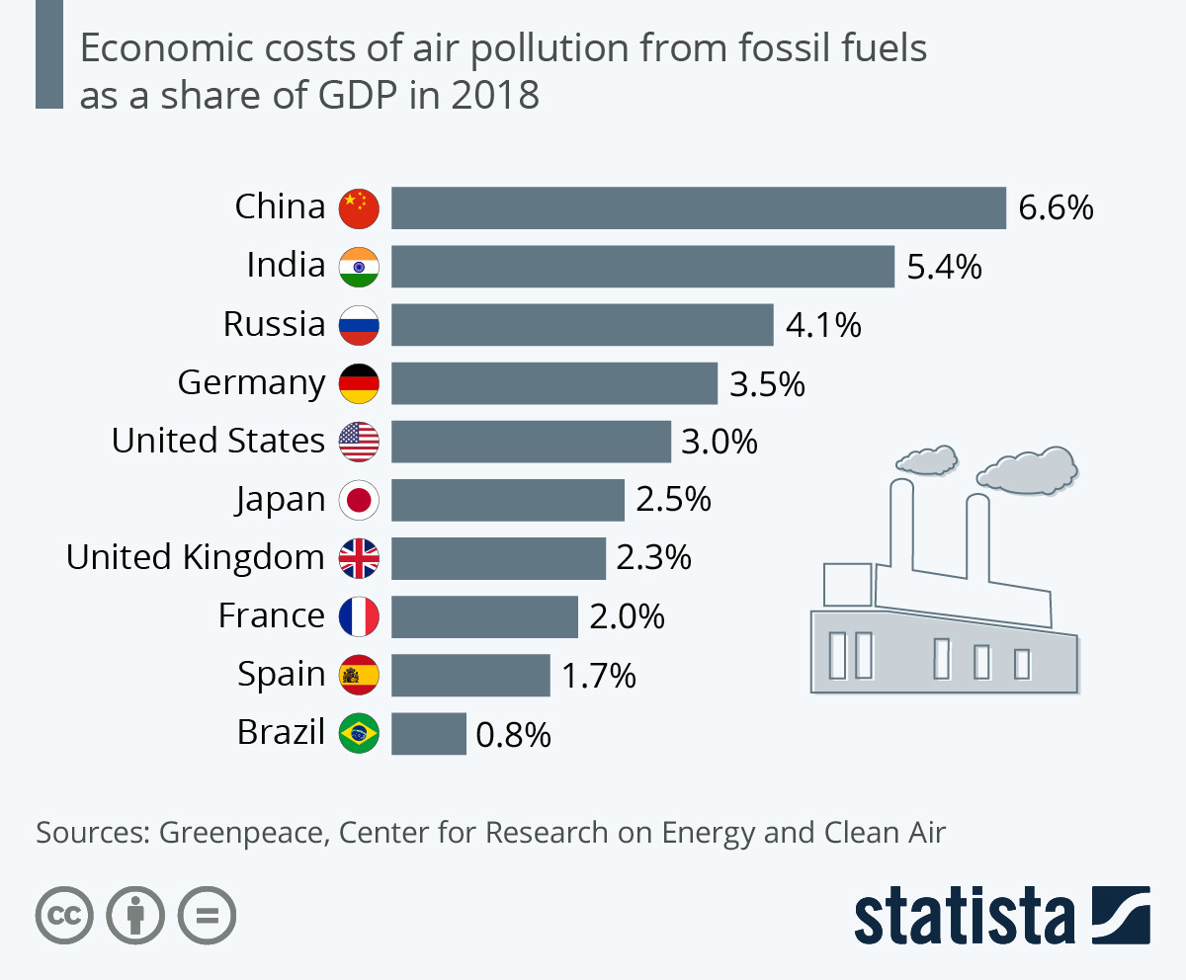
Global economic cost of air pollution

Slide 3
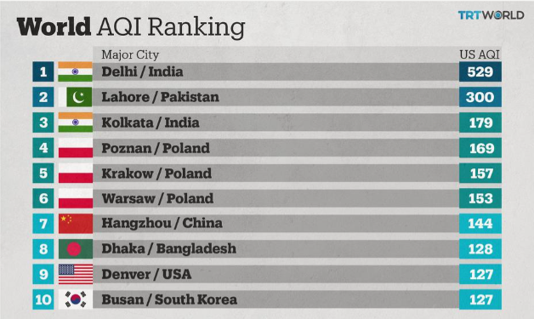

Slide 4
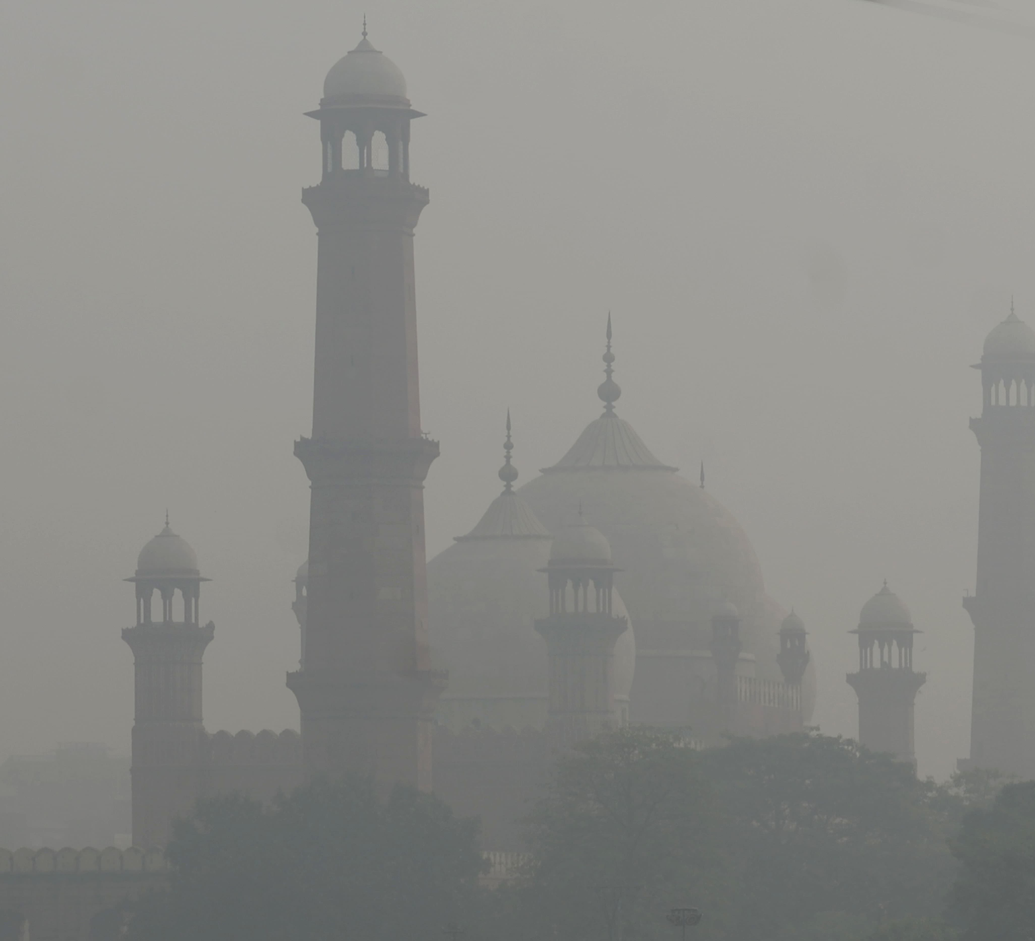
The problem
Lahore Smog

Slide 5
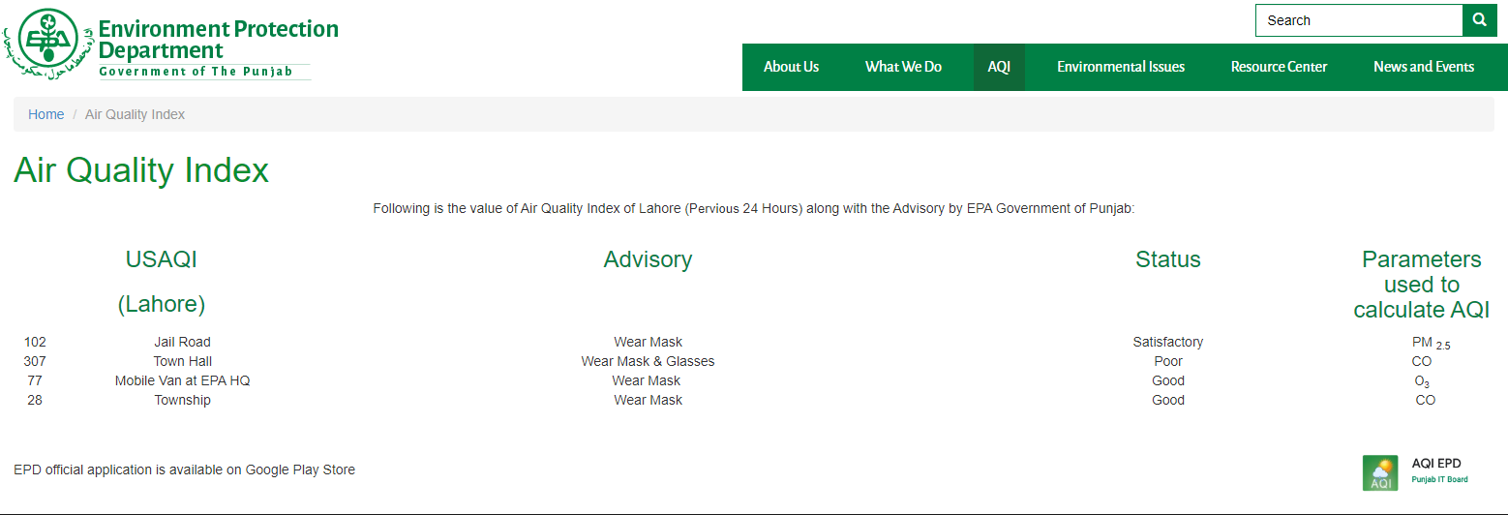
Our Governments role

Slide 6
Objectives
To detect the level of Air pollution and calculate Air quality Index.
To detect the SMOG and its origin.
To make modular devices.

Slide 7
What we propose
Monitoring of the pollutants like (CO, SO,NO2, PM2.5, etc.)
Cloud platform for Real-Time data collection
Website for user interaction

Slide 8
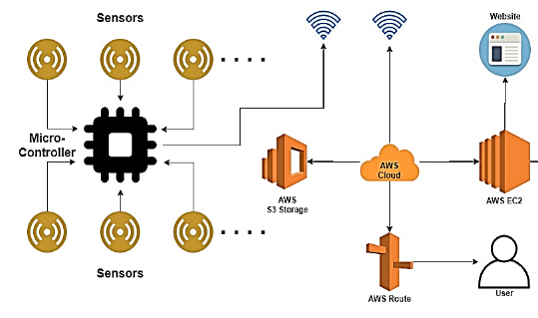
Block Diagram

Slide 9
THANK YOU
Questions AND SUGGESTIONS?

